Slide 1
Guessing Number Game
A multiplayer game that generates random numbers during each round
Yashwant Kumar Vishnumolakala
Student ID: U01929211

Slide 2
INTRODUCTION
Classic Interactive Game
Feedback and Guessing
Engaging and Intuitive

Slide 3
Logic
The following functions have been used for this program;
Calculate accuracy - calculate the absolute difference between the guessed and actual number
Guess the number – Specify attempts and guide the players’ guesses.
Main – Organizes the program’s main functionality. Initializes the code, chooses a random number and facilitates each round.

Slide 4
Material used
Python Functions (w3schools.com)
Number guessing game in Python 3 and C – GeeksforGeeks
Python Number Guessing Game - Python Guides
Pygame - https://www.pygame.org/news

Slide 5
Customizations
Program guides the user on whether the guessed value is either higher or lower than the actual value.
Ranks the played users based on their percentage accuracy.
I have used a dedicated function for all key sections of the code. This made it easier to customize each part.

Slide 6
Lessons learnt
Error handling – Deal with unexpected user input.
Algorithmic thinking – Designing a fair and engaging game logic.
Ranking and sorting techniques – To determine the best performing players.
Code encapsulation – Used to manage code complexity and redability

Slide 7
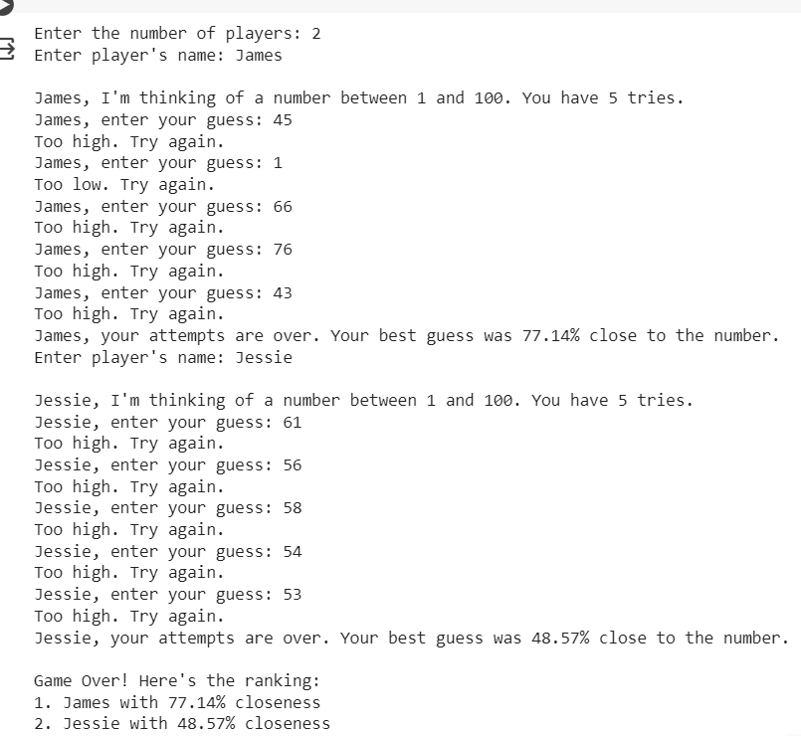
Output

Slide 8


